Slide 1


Webmarkup
Lecture 2
[3 EC, 84 SBU , Product]
Location : Haarlem
Micha van der Meer (INF) , Frank Dersjant (IT)
Version 2.05
Notes:
company logo are respective owned by the company
Photo’s used are royalty free and under (CC0) license pixels.com
All other not mentioned graphics or text are © Witan BV
Questions ? Lecture material owner micha van der Meer

Slide 2

Course planning
Term 1 – 19/20 |  | Week
Lecture 1 | Introduction, Webmarkup setup | 36
Lecture 2 | Basic HTML | 37
Lecture 3 | Advanced HTML | 38
Lecture 4 | Basic CSS | 39
Lecture 5 | Advanced CSS | 40
Lecture 6 | Expert CSS + provision and explaining (end)assessment | 41
Lecture 7 | Webmarkup development tools | 42
Exam weeks | Finishing assessment | 44 – 45
10 November 2019 23:59 | Deadline assessment | 45
2

Slide 3

Questions about previous lectures?
Eur 32.400
Webmarkup is logic
Notepad ++
Web browsers
Github
SAAS, PAAS & NAS
Filezilla
Resources on internet
Homework
3

Slide 4




Right and wrong
4
Notes:
(CC0) license

Slide 5

Quiz
5 min
HTML 5 or not? | Right | Wrong
I. <!DOGTYPE HTML>
II. <html lang=“ko”>
III. <ul><li><ul><li>
IV. <a url="http://www.taekwon.nl">link</a>
V. WebMail.UserName = "micha@mma-games.com";
VI. <h6>Inholland</h6>
VII. <title name=“This website is great" />
5
Notes:
Typo, there are no dogs in HTML and html is in lower case and it is not <!DOGTYPE html5> (the tag )
Yes, double quote is “auto correct” by powerpoint
Missing some closing tags
!url -> href
Asp
<tilte></title> and content questions.

Slide 6

Why we are learning HTML5
6
Notes:
15 % still using Flash.
88% of the sites are using JavaScript.
0.1 % Java.
But you like to develop something in 3D.

Slide 7



Why we are learning HTML5 [History of Flash]
!=
2007
7
Notes:
Who is this?
When was the introduction from the iPhone
Steve Jobs introduced the iPhone 1 in 2007!
© Photo Steve Jobs at the 2010 Worldwide Developers Conference by Matt Yohe. matt.yohe@gmail .com.

Slide 8


Why we are learning HTML5 [native app development]
8
Notes:
APP development is out of scope
Unity3D -> Games 3rd year game development

Slide 9

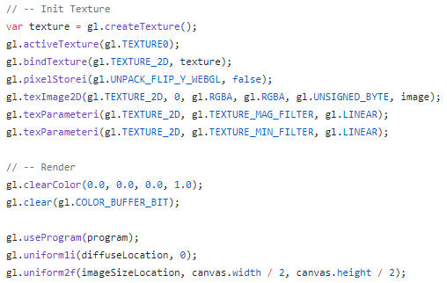
Why we are learning HTML5 [3D development]
9
Notes:
OUT OF SCOPE!
WebGL is an open standard for 3D development.
https://www.chromeexperiments.com/experiment/fluid-particles

Slide 10


Why we are learning HTML5 [convert website to app]
10
Notes:
OUT OF SCOPE!
2nd and 3rd Year
https://www.appypie.com/convert-website-to-mobile-apps
https://cordova.apache.org/docs/en/latest/guide/cli/

Slide 11


HTML vs CSS [Resume lecture 1]
[HTML]
HTML (HyperText Markup Language) is the language in which you structurize the webpage
HTML divides documents in parts/sections
[CSS]
Colours
Margins
Positioning
Style
11
Notes:
(CC0) license

Slide 12

HTML 5 – Family (work in progress)
HTML5
CSS3 (Cascade Style Sheets versie 3)
JavaScript
 | 2012 | 2013 | 2014 | 2015 | 2016 | 2017
5.0 | Candidate Rec | Call for Review | Recommen-dation
5.1 | 1st Working Draft |  | Last Call | Candidate Rec | Recommen- dation
5.2 |  |  |  | 1st Working Draft |  | Dec 2017
12
Notes:
2018-11-08Timed Text Markup Language 2 (TTML2)
The Timed Text Markup Language is a content type that represents timed text media for the purpose of interchange among authoring systems and for distribution for example as a format to reference from an HTML element. Timed text is textual information that is intrinsically or extrinsically associated with timing information.
2018-02-01HTML Media Capture
This specification defines HTML form enhancements that provide access to the audio, image and video capture capabilities of the device.
2017-12-14HTML 5.2
This specification defines the 5th major version, second minor revision of the core language of the World Wide Web: the Hypertext Markup Language (HTML). In this version, new features continue to be introduced to help Web application authors, new elements continue to be introduced based on research into prevailing authoring practices, and special attention continues to be given to defining clear conformance criteria for user agents in an effort to improve interoperability.

Slide 13
HTML 5 – What is new
Audio & Video [multimedia support]
Input element types [type = email]
Field and range validators [min=“6” max=“16”]
Canvas [painting]
Custom data attributes [JS & JQuery]
Editable content [User interaction]
Media Queries [max-width: 640px]
API [Application Programming Interfaces]
Geolocation [Position]
13
Notes:
<video src="Video file path" controls>
<input id="EmailIdInput" type="email" />
<input type="number" name="NumberOfItems" min="10" max="50" required/>
<canvas id="myCanvas" width="200" height="100">
<span class="user" data-domain="Technology" data-language="C#">
<p contenteditable="true">Click here to edit this content!</p>
[max-width: 640px]
Like : Drag drop , Local storage, Web workers, SSE (Server-Sent Events)
https://www.w3schools.com/html/html5_geolocation.asp

Slide 14

DOCTYPES in HTML
14
Notes:
(CC0) license
Any questions about terms. Please let us know. If we talk about doc types and all you can think is a dog…

Slide 15
DOCTYPES in HTML
<!DOCTYPE HTML> <html> <body> <video width=“640" height="480" controls> <source src=“diablo3.mp4" type="video/mp4"> <source src=“diablo3.ogg" type="video/ogg"> Your browser do not support loot goblins. </video> </body>
</html> </html>
XHTML 1.0 Strict
XHTML 1.0 Transitional
…..
HTML 4.0.1 Strict
HTML 5
15
Notes:
XHTML (Extensible Hypertext Markup Language)
Strict (error and does not validate) -> does NOT INCLUDE presentational or deprecated elements
Elements that are not allowed in Strict DOCTYPEs
center
font
iframe
strike
u
Attributes not allowed in Strict DOCTYPEs
align (allowed on elements related to tables: col, colgroup, tbody, td, tfoot, th, thead, and tr)
language
background
bgcolor
border (allowed on table)
height (allowed on img and object)
hspace
name (allowed in HTML 4.01 Strict, not allowed on form and img in XHTML 1.0 Strict)
noshade
nowrap
target
text, link, vlink, and alink
vspace
width (allowed on img, object, table, col, and colgroup)

Slide 16

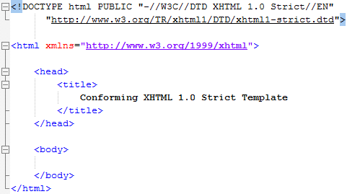
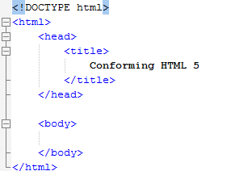
HTML – Compare versions
HTML Strict 1.0
HTML5
16
Notes:
Why ?
SEO , TV, Mobile
https://hsivonen.fi/doctype/

Slide 17

HTML – Compare versions
HTML Strict 1.0
HTML5
17
Notes:
Why ?
SEO , TV, Mobile
https://hsivonen.fi/doctype/

Slide 18
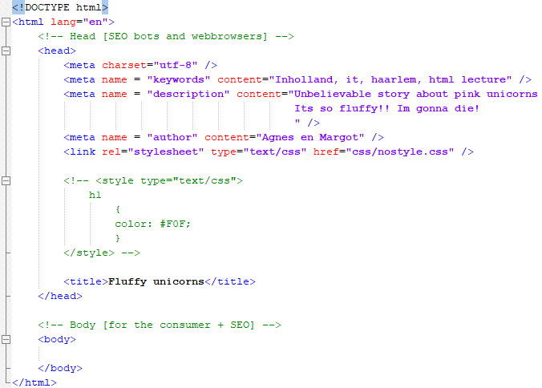

HTML – Structure <body>
18
Notes:
<head></head>

Slide 19
HTML – Structure
USE TABS
19
Notes:
USE TABS!

Slide 20
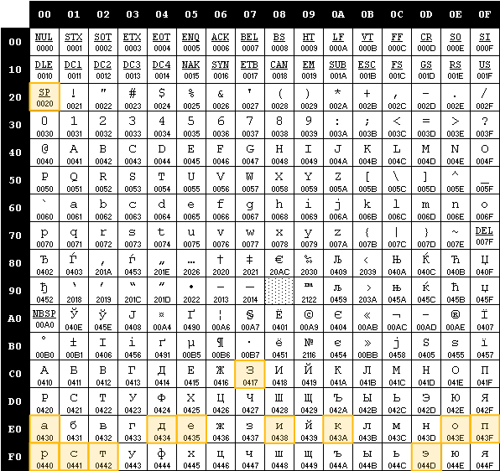
HTML – <meta charset="utf-8">
20
Notes:
Greek alphabet -> 26 letters !

Slide 21
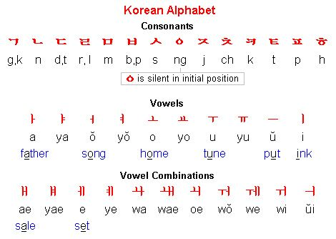

HTML – <meta charset="utf-8“ /> ?
21
Notes:
Hangul have 14 consonants and 10 vowels (in theory 24 letters) so this could fit in 255 spaces from UTF 8.

Slide 22
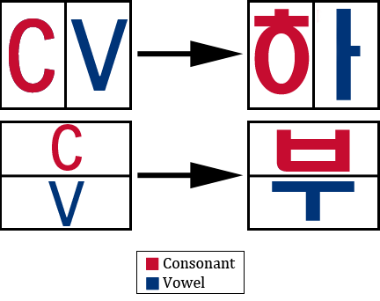
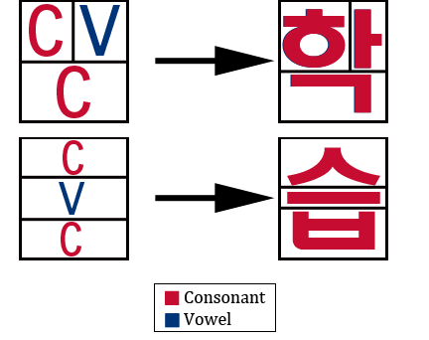
HTML – <meta charset="utf-8“ /> ?
22
Notes:
Hangul have 14 consonants and 10 vowels (in theory 24 letters) so this could fit in 255 spaces from UTF 8.

Slide 23
HTML – <meta charset="utf-8“ /> ?
 | 0x00 | 0x01 | 0x02 | 0x03 | 0x04 | 0x05 | 0x06 | 0x07 | 0x08 | 0x09 | 0x0A | 0x0B | 0x0C | 0x0D | 0x0E | 0x0F
0xac00 | 가 | 각 | 갂 | 갃 | 간 | 갅 | 갆 | 갇 | 갈 | 갉 | 갊 | 갋 | 갌 | 갍 | 갎 | 갏
0xac10 | 감 | 갑 | 값 | 갓 | 갔 | 강 | 갖 | 갗 | 갘 | 같 | 갚 | 갛 | 개 | 객 | 갞 | 갟
0xac20 | 갠 | 갡 | 갢 | 갣 | 갤 | 갥 | 갦 | 갧 | 갨 | 갩 | 갪 | 갫 | 갬 | 갭 | 갮 | 갯
0xac30 | 갰 | 갱 | 갲 | 갳 | 갴 | 갵 | 갶 | 갷 | 갸 | 갹 | 갺 | 갻 | 갼 | 갽 | 갾 | 갿
0xac40 | 걀 | 걁 | 걂 | 걃 | 걄 | 걅 | 걆 | 걇 | 걈 | 걉 | 걊 | 걋 | 걌 | 걍 | 걎 | 걏
0xac50 | 걐 | 걑 | 걒 | 걓 | 걔 | 걕 | 걖 | 걗 | 걘 | 걙 | 걚 | 걛 | 걜 | 걝 | 걞 | 걟
0xac60 | 걠 | 걡 | 걢 | 걣 | 걤 | 걥 | 걦 | 걧 | 걨 | 걩 | 걪 | 걫 | 걬 | 걭 | 걮 | 걯
0xac70 | 거 | 걱 | 걲 | 걳 | 건 | 걵 | 걶 | 걷 | 걸 | 걹 | 걺 | 걻 | 걼 | 걽 | 걾 | 걿
0xac80 | 검 | 겁 | 겂 | 것 | 겄 | 겅 | 겆 | 겇 | 겈 | 겉 | 겊 | 겋 | 게 | 겍 | 겎 | 겏
0xac90 | 겐 | 겑 | 겒 | 겓 | 겔 | 겕 | 겖 | 겗 | 겘 | 겙 | 겚 | 겛 | 겜 | 겝 | 겞 | 겟
0xaca0 | 겠 | 겡 | 겢 | 겣 | 겤 | 겥 | 겦 | 겧 | 겨 | 격 | 겪 | 겫 | 견 | 겭 | 겮 | 겯
0xacb0 | 결 | 겱 | 겲 | 겳 | 겴 | 겵 | 겶 | 겷 | 겸 | 겹 | 겺 | 겻 | 겼 | 경 | 겾 | 겿
0xacc0 | 곀 | 곁 | 곂 | 곃 | 계 | 곅 | 곆 | 곇 | 곈 | 곉 | 곊 | 곋 | 곌 | 곍 | 곎 | 곏
0xacd0 | 곐 | 곑 | 곒 | 곓 | 곔 | 곕 | 곖 | 곗 | 곘 | 곙 | 곚 | 곛 | 곜 | 곝 | 곞 | 곟
0xace0 | 고 | 곡 | 곢 | 곣 | 곤 | 곥 | 곦 | 곧 | 골 | 곩 | 곪 | 곫 | 곬 | 곭 | 곮 | 곯
0xacf0 | 곰 | 곱 | 곲 | 곳 | 곴 | 공 | 곶 | 곷 | 곸 | 곹 | 곺 | 곻 | 과 | 곽 | 곾 | 곿
0xad00 | 관 | 괁 | 괂 | 괃 | 괄 | 괅 | 괆 | 괇 | 괈 | 괉 | 괊 | 괋 | 괌 | 괍 | 괎 | 괏
0xad10 | 괐 | 광 | 괒 | 괓 | 괔 | 괕 | 괖 | 괗 | 괘 | 괙 | 괚 | 괛 | 괜 | 괝 | 괞 | 괟
0xad20 | 괠 | 괡 | 괢 | 괣 | 괤 | 괥 | 괦 | 괧 | 괨 | 괩 | 괪 | 괫 | 괬 | 괭 | 괮 | 괯
0xad30 | 괰 | 괱 | 괲 | 괳 | 괴 | 괵 | 괶 | 괷 | 괸 | 괹 | 괺 | 괻 | 괼 | 괽 | 괾 | 괿
23
Notes:
All can be combined with each other - giving a total of 11,172 different hangul.
http://www.fileformat.info/info/unicode/block/hangul_syllables/utf8test.htm

Slide 24
HTML – Structure, value
<title>Fluffy unicorn</title> Element
<meta /> , <title>,</title> Tags [single and paired]
charset, name, etc Attribute
utf-8, keywords, etc Value
24

Slide 25
HTML – Element & tags
ELEMENT
<title> Unicorns </title>
“OPENING”-TAG
TEXT
“CLOSING”-TAG
25

Slide 26

HTML – Attributes
ELEMENT
<meta charset="utf-8" />
TAG
ATTRIBUTE
TAG
ATTRIBUTE NAME
ATTRIBUTE VALUE
Attributes are case sensitive! CharSet = “utf-8”
26
Notes:
UTF8

Slide 27
HTML – Localization
ELEMENT
<html lang="en" />
TAG
ATTRIBUTE
TAG
ATTRIBUTE NAME
ATTRIBUTE VALUE
lang = “en” is not mandatory but can come in handy. (when using a screenreader for example)
27
Notes:
UTF8

Slide 28

Assignment lecture 2.1
Create a webpage “index_lecture2_1.html”
Add a title
Add meta information.
charset
name keywords for a website about you
description for a website about you
author
Test your website on Chrome, Edge and Firefox
Commit work on GitHub
FTP your work on your webserver
20 min
28
Notes:
Royalty free (CC0) license
Teacher guide : Min 30 – 40 (from 135 min)
TEST -> You will see your website title in the browser!

Slide 29
HTML – Body of the Webpage
29
Notes:
<body></body>

Slide 30
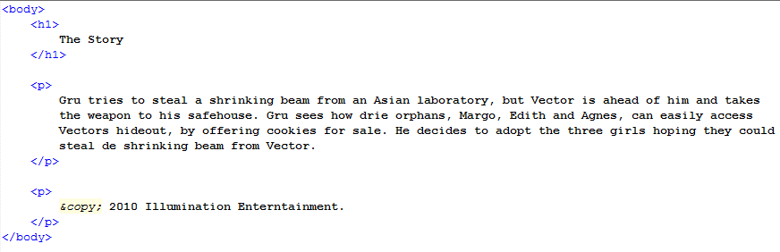
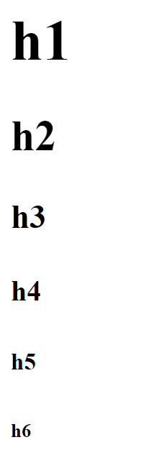
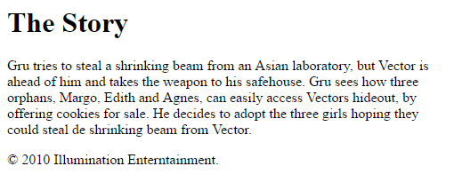
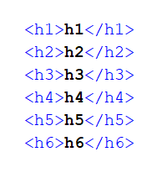
HTML – Entities
Result | Description | Entity Name | Entity Number
 | non-breaking space | &nbsp; | &#160;
< | less than | &lt; | &#60;
> | greater than | &gt; | &#62;
& | ampersand | &amp; | &#38;
" | double quotation mark | &quot; | &#34;
' | single quotation mark (apostrophe) | &apos; | &#39;
¢ | cent | &cent; | &#162;
£ | pound | &pound; | &#163;
¥ | yen | &yen; | &#165;
€ | euro | &euro; | &#8364;
© | copyright | &copy; | &#169;
® | registered trademark | &reg; | &#174;
<h1> </h1> tag
<p> </p> tag
align="right“ [HTML 4.01] attribute & value
30
Notes:
Entities,
<p> should be a footer,.. But this later :P

Slide 31
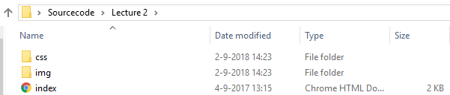
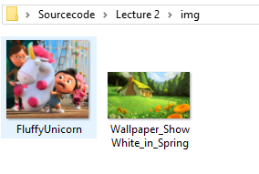
HTML – Images in the /img folder
31
Notes:
Despicable me ©2010 Illumination Entertainment

Slide 32
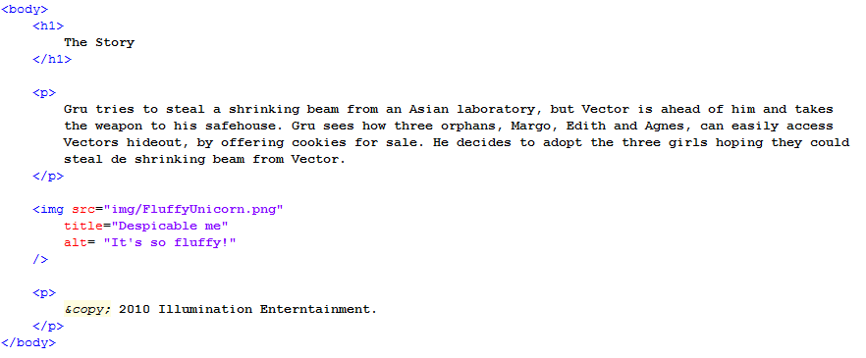
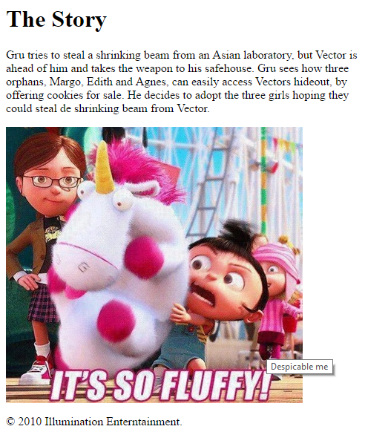
HTML – Images
<img /> tag
src = “url/folder/filename.ext” attribute, value
titel = “linkin park - recharge” attribute, value
alt = “improve the world” attribute, value
width =“100px“ [HTML 4.01] attribute & value
heigth =“100px“ [HTML 4.01] attribute & value
32
Notes:
DO NOT ADD STYLE IN HTML!
It is possible but 50 shades of grey :P

Slide 33
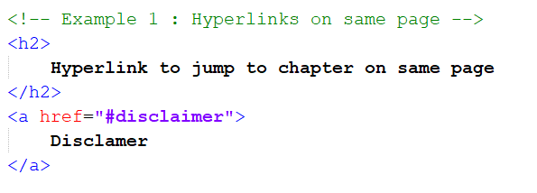
HTML – <!-- comment HTML sourcecode -->
33

Slide 34

HTML – Hyperlink [1/4]
34

Slide 35
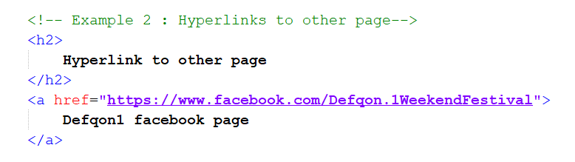
HTML – Hyperlink [2/4]
35

Slide 36
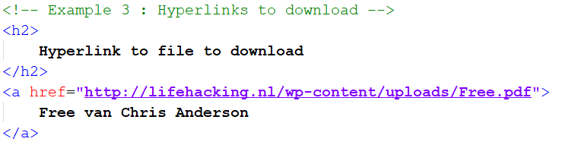
HTML – Hyperlink [3/4]
36

Slide 37
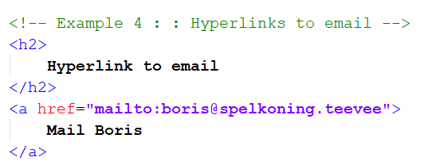

HTML – Hyperlink [4/4]
37
Notes:
Use only for testing.. Normally use form and php / asp backend.

Slide 38
Assignment lecture 2.2
Copy webpage “index_lecture2_1.html” to “index_lecture2_2.html”.
Add heading 1 and heading 2.
Add a paragraph with a small story about yourself.
Add your hyperlink to your own LinkedIn page.
Add a small paragraph where you visit London, New York and Paris and where you bought souvenirs with $, € and £. Use entities for the currencies.
Find a picture on internet that has a resolution of 300px by 300px and add this to your webpage. (https://placeimg.com/)
Test your website on Chrome, Edge and Firefox.
Summit work on GitHub.
FTP your work on your webserver.
20 min
38
Notes:
Royalty free (CC0) license
Teacher guide : Min 60 – 70 (from 135 min)
TEST -> You will see your website title in the browser!

Slide 39
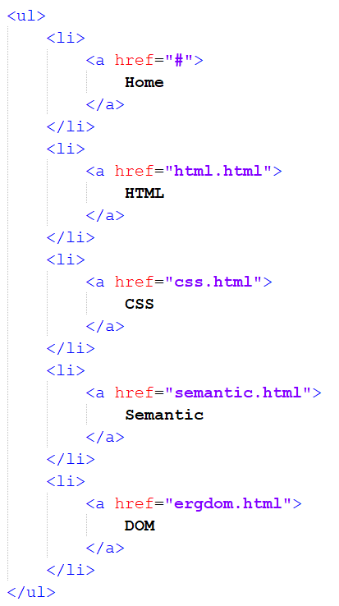
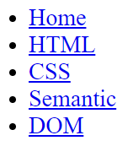
HTML – Unordered list
39

Slide 40
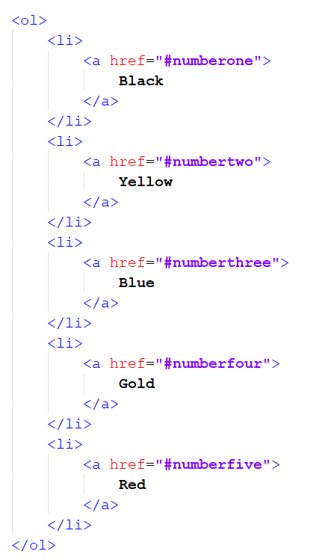
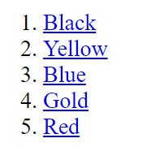
HTML – Ordered list
40

Slide 41
HTML – Table
<table> = table
<tr> = table row
<th> = table head
<td> = table data
41

Slide 42
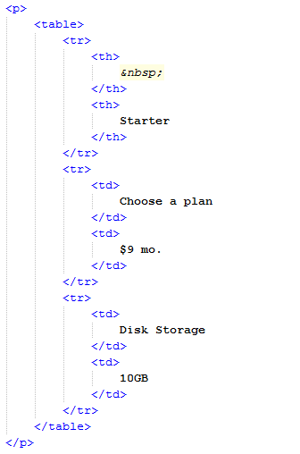

HTML – Table
42

Slide 43
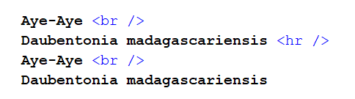
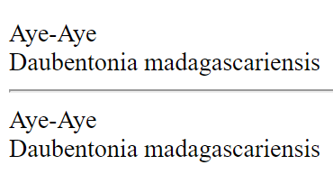
HTML – Forbidden elements
43
Notes:
All design :P

Slide 44
HTML – Block and Inline elements
Block-level elements
<address> <article> <aside> <blockquote> <canvas> <dd> <div> <dl> <dt> <fieldset> <figcaption> <figure> <footer> <form> <h1>-<h6> <header> <hr> <li> <main> <nav> <noscript> <ol> <output> <p> <pre> <section> <table> <tfoot> <ul> <video>
Inline elements
<a> <abbr> <acronym> <b> <bdo> <big> <br> <button> <cite> <code> <dfn> <em> <i> <img> <input> <kbd> <label> <map> <object> <q> <samp> <script> <select> <small> <span> <strong> <sub> <sup> <textarea> <time> <tt> <var>
44
Notes:
All design :P

Slide 45
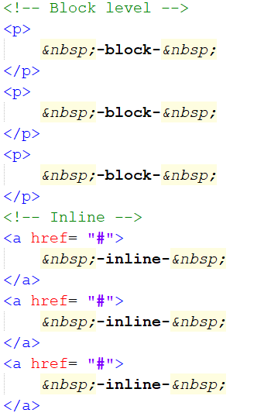
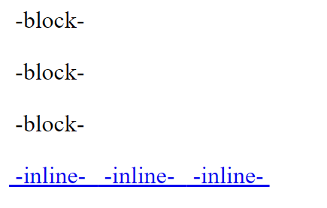
HTML – Block and Inline elements
45
Notes:
All design :P

Slide 46
Assignment lecture 2.3
Copy webpage “index_lecture2_2.html” to “index_lecture2_3.html”.
Add an ordered list from your top 5 snacks you love to eat.
Add an unordered “bucket list” with 5 things you like to do before you die.
Add table with the courses you follow in the next weeks. In the table header; course name, EC’s, expected time on homework, expected grade.
Add 3 inline elements and 3 block elements on the page.
Test your website on Chrome, Edge and Firefox.
Summit work on GitHub.
FTP your work on your webserver.
20 min
46
Notes:
Royalty free (CC0) license
Teacher guide : Min 90 – 100 (from 135 min)
TEST -> You will see your website title in the browser!
[feb 19]Suzanne, thanks for the correction in the Assignment

Slide 47

Resume lecture
What is HTML5
Doctypes
Flash, WebGL, Cordova and Unity3D
HTML structure [Tabs]
UTF-8
Meta info
Single and paired tags
Elements and attributes
Head & Body
Head 1 – 6 <h1>
Paragraphs <p>
Entities &nbsp;
Images <img />
Hyperlinks <a>
Lists <ul><ol>
Tables <table>
Block and inline elements
47
Notes:
(CC0) license

Slide 48

Next week
DOM
HTML Advance
Quotes
Computer code
Abbreviations
Defining instance
Defining list
Insert & delete
Strong & emphasis
Head elements (part2)
Forms
Semantic (part 2)
Divs
Audio & Video
Validation
48
Notes:
(CC0) license

Slide 49

Questions
49
Notes:
(CC0) license

Slide 50
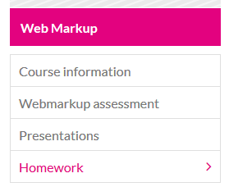
Homework for next lecture
50

